Slide 1
Introduction to PyTorch
CS236 Section, Autumn 2024
Honglin Chen

Slide 2
What is Pytorch?
A machine learning framework that accelerates the path from research prototyping to production deployment
Machine learning framework
Deep learning primitives such as data loading, NN layer types, activations, loss functions, and optimizers
Hardware acceleration on NVIDIA GPUs
Libraries for vision, NLP, and audio applications
Research prototyping
Models are Python code, Automatic differentiation, and eager mode
Production deployment
TorchScript, TorchServe, quantization
Notes:
Adapted from Pytorch official tutorial: https://www.youtube.com/watch?v=IC0_FRiX-sw

Slide 3
Overview
Motivations
Python
NumPy
Building Blocks
Tensors
Operations
Modules
Examples
MNIST
Beyond PyTorch
Tools
High Level Libraries
Domain Specific Libraries

Slide 4
Motivations
Python vs. NumPy
X = [1] * 10000
Y = [0.5] * 10000
Z = [None] * 10000
for i in range(10000):
Z[i] = X[i] * Y[i]
# 2.772092819213867 ms
# Interpreter Overhead
# 64 bit
X = np.full((10000,), 1)
Y = np.full((10000,), 0.5)
Z = X * Y
# 0.08273124694824219 ms
# Low Level Implementation
# Vectorization

Slide 5
Motivations
NumPy vs. PyTorch
X = np.full((10000,), 1)
Y = np.full((10000,), 0.5)
Z = X * Y
# 0.08273124694824219 ms
# Low Level Implementation
# Vectorization
X = torch.full((10000,), 1).cuda()
Y = torch.full((10000,), 0.5).cuda()
Z = X * Y
# 0.3185272216796875 ms
# GPU Acceleration
Z.sum().backward()
dX = X.grad
# Automatic Differentiation

Slide 6
Building Blocks
TENSORS

Slide 7
Building Blocks
Tensors / Initialization
torch.tensor([5., 3.])
tensor([ 5., 3.,]) # defaults to torch.float32
torch.from_numpy(np.array([5., 3.]))
tensor([ 5., 3.,], dtype=torch.float64) # because numpy defaults to 64bit
torch.tensor([5., 3.]).numpy()
array([5., 3.], dtype=float32)

Slide 8
Building Blocks
Tensors / Initialization
torch.ones(5, 3)
tensor([[1., 1., 1.], [1., 1., 1.], [1., 1., 1.], [1., 1., 1.], [1., 1., 1.]], dtype=torch.float64)

Slide 9
Building Blocks
Tensors / Initialization
torch.randn(5, 3)
tensor([[ 0.2349, -0.0427, -0.5053], [ 0.6455, 0.1199, 0.4239], [ 0.1279, 0.1105, 1.4637], [ 0.4259, -0.0763, -0.9671], [ 0.6856, 0.5047, 0.4250]])

Slide 10
Building Blocks
Tensors / Initialization
torch.ones_like(tensor)
Input: tensor([[ 0.2349, -0.0427, -0.5053], [ 0.6455, 0.1199, 0.4239]])
Output: tensor([[1., 1., 1.], [1., 1., 1.], dtype=torch.float64)

Slide 11
Building Blocks
Tensors / Initialization
torch.empty(5, 3)
tensor([[ 0.0000e+00, 2.5244e-29, 0.0000e+00],
[ 2.5244e-29, 1.4569e-19, 2.7517e+12],
[ 7.5338e+28, 3.0313e+32, 6.3828e+28],
[ 1.4603e-19, 1.0899e+27, 6.8943e+34],
[ 1.1835e+22, 7.0976e+22, 1.8515e+28]])
# The values are not initialized

Slide 12
Building Blocks
Tensors / Indexing & Reshaping
torch.tensor([[5., 3.]])[0, :]
tensor([ 5., 3.,])
torch.tensor([[5., 3.]]).view(-1) # infer dimension size
torch.tensor([[5., 3.]]).view(2)
tensor([ 5., 3.,])
torch.tensor([[5., 3.]]).size()
torch.Size([1, 2])

Slide 13
Building Blocks
Tensors / Broadcasting
X = torch.ones((3, 3, 3))
Y = torch.ones((1, 1, 3))
Z = X * Y
Z.size()
torch.Size([3, 3, 3])
# https://pytorch.org/docs/stable/notes/broadcasting.html

Slide 14
Building Blocks
Tensors / Devices
if torch.cuda.is_available(): device = torch.device("cuda") # a CUDA device object x = torch.ones(2, device=device) # directly create a tensor on GPU y = torch.ones(2).to(device) # or just use strings `.to("cuda")` z = x + y print(z) # z is on GPU print(z.to("cpu", torch.double)) # to(‘cpu’) moves array to CPU
# `x.cuda()` and `x.cpu()` also works

Slide 15
Building Blocks
Operations / Primitives
torch.tensor([5., 3.]) + torch.tensor([3., 5.])
tensor([ 8., 8.,])
z = torch.add(x, y)
torch.add(x, y, out=z)
y = y.add_(x) # inplace y += x
torch.tanh(y)
torch.stack([x, y])
# https://pytorch.org/docs/stable/torch.html

Slide 16
Building Blocks
Operations / Functional
import torch.nn.functional as F
X = torch.randn((64, 3, 256, 256))
W = torch.randn((8, 3, 3, 3)
out = F.conv2d(X, W, stride=1, padding=1)
# Like SciPy
# https://pytorch.org/docs/stable/nn.functional.html

Slide 17
Building Blocks
Operations / Automatic Differentiation
Computation as a graph built at runtime
x = torch.ones(2, 2, requires_grad=True)
tensor([[1., 1.], [1., 1.]], requires_grad=True)
y = x + 2
tensor([[3., 3.], [3., 3.]], grad_fn=<AddBackward0>)
x
2
∂+
y

Slide 18
Building Blocks
Operations / Automatic Differentiation
z = y * 3 out = z.mean()
tensor(9., grad_fn=<MeanBackward1>)
out.backward() # Must be scalar
print(x.grad) # Only leaf nodes have grad
Gradient w.r.t. the input Tensors is computed step-by-step from loss to the top in reverse
x
2
∂+
y
3
∂*
z
∂mean
out

Slide 19
Building Blocks
Operations / Automatic Differentiation
x.requires_grad # True (x ** 2).requires_grad # True
# Keeping track of activations is expensive
with torch.no_grad(): (x ** 2).requires_grad # False
(x.detach() ** 2).requires_grad # False

Slide 20
Building Blocks
Operations / nn
import torch.nn as nn
X = torch.ones((64, 3, 256, 256))
conv = nn.Conv2D(in_channels=3,
out_channels=8,
kernel_size=3,
stride=1,
padding=1)
out = conv(img)
import torch.nn.functional as F
X = torch.randn((64, 3, 256, 256))
W = torch.randn((8, 3, 3, 3)
out = F.conv2d(X, W,
stride=1, padding=1)
# Inherits from nn.Module
# Implemented using functional
# Stores internal states

Slide 21
Building Blocks
Operations / Module
import torch.nn as nn
X = torch.ones((64, 3, 256, 256))
conv = nn.Conv2D(in_channels=3,
out_channels=8,
kernel_size=3,
stride=1,
padding=1)
# Move the module to GPUs
conv.cuda()
# Saves states
conv.state_dict()
# Saves trainable states
conv.parameters()
# Recursively visit child modules
conv.apply(weight_init)

Slide 22
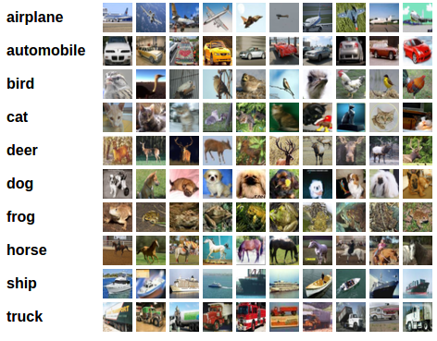
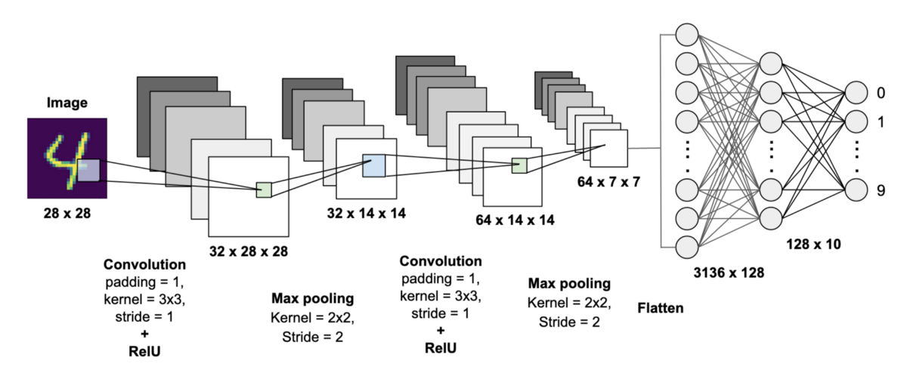
Examples
MNIST

Slide 23
Example
MNIST
Preprocessing
Dataloader
Network
Optimizer
Training

Slide 24
Examples
MNIST / Preprocessing
import torchvision.transforms as transforms
transform = transforms.Compose(
[transforms.ToTensor(),
transforms.Normalize((0.5, 0.5, 0.5), (0.5, 0.5, 0.5))])
# Convert to Torch Tensor and perform normalization
# https://pytorch.org/vision/stable/transforms.html
# e.x Color Jitter, Five Crops

Slide 25
Examples
MNIST / Dataloader
Import torch
import torchvision
trainset = torchvision.datasets.CIFAR10(
root='./data', train=True,
download=True, transform=transform)
# Dataloaders are python iterators
trainloader = torch.utils.data.DataLoader(
trainset, batch_size=8,
shuffle=True, num_workers=2)

Slide 26
Examples
MNIST / Network
import torch.nn as nn
class Net(nn.Module):
def __init__(self):
super().__init__()
self.conv1 = nn.Conv2d(3, 6, 5)
self.pool = nn.MaxPool2d(2, 2)
self.conv2 = nn.Conv2d(6, 16, 5)
self.fc1 = nn.Linear(16 * 5 * 5, 120)
self.fc2 = nn.Linear(120, 84)
self.fc3 = nn.Linear(84, 10)

Slide 27
Examples
MNIST / Network
import torch.nn.functional as F
class Net(nn.Module):
def __init__(self):
...
def forward(self, x):
x = self.pool(F.relu(self.conv1(x)))
x = torch.flatten(self.pool(F.relu(self.conv2(x))))
x = F.relu(self.fc1(x))
x = F.relu(self.fc2(x))
return self.fc3(x)

Slide 28
Examples
MNIST / Optimizer
import torch.optim as optim
# Instantiate nn.Module (Use default weights)
net = Net().to(“cuda”)
# Define loss function
criterion = nn.CrossEntropyLoss()
# Create optimizer: https://pytorch.org/docs/stable/optim.html
optimizer = optim.SGD(net.parameters(), lr=0.001, momentum=0.9)

Slide 29
Examples
MNIST / Training
net.train() # Set to training mode (there is also `net.eval()`)
for epoch in range(2):
for inputs, labels in trainloader:
# zero the parameter gradients
optimizer.zero_grad()
# forward + backward + optimize
outputs = net(inputs.to(“cuda”))
loss = criterion(outputs, labels.to(“cuda”))
loss.backward()
optimizer.step()

Slide 30
Examples
MNIST / Recap
... transforms.Compose( ... # Define preprocessing transforms
... torch.utils.data.DataLoader( ... # Create Dataloader
... def Net(nn.Module): ... # Define Network
... criterion = nn.CrossEntropyLoss() ... # Define loss function
... optim.SGD(net.parameters(), ... # Create Optimizer
... for x, y in trainloader: ... # Iterate over Dataloader
... outputs = net(inputs) # Forward Pass
... criterion(outputs, labels) ... # Compute Loss
... optimizer.zero_grad() ... # Zero out gradients
... loss.backward() ... # Back Propagate
... optimizer.step() ... # Update weights

Slide 31
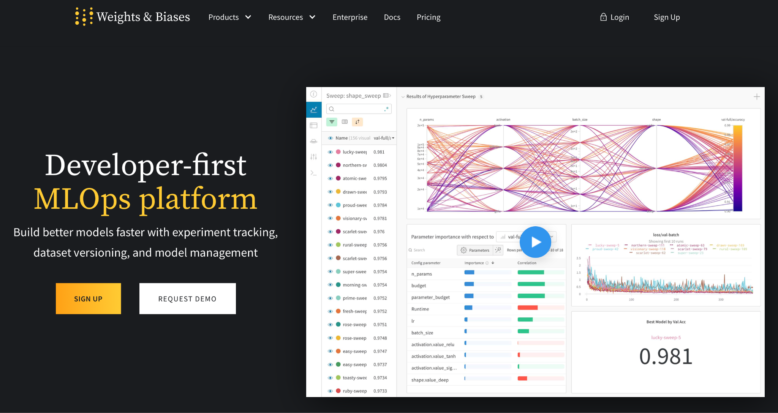

Beyond PyTorch
Tools / Keep Track of experiments, artifacts

Slide 32
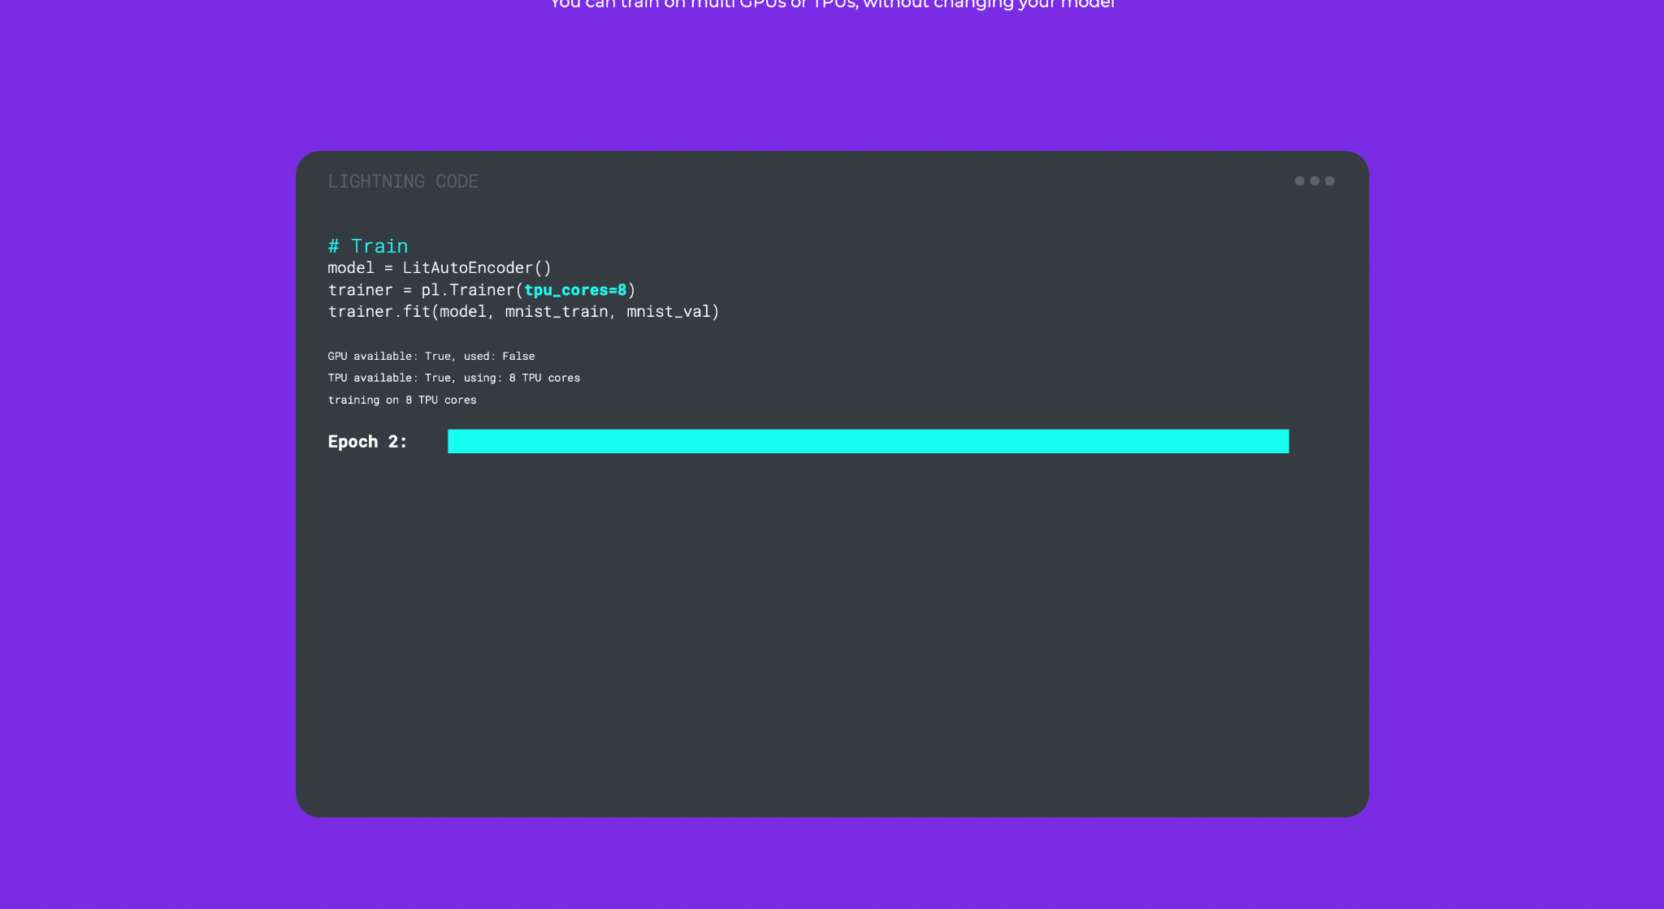
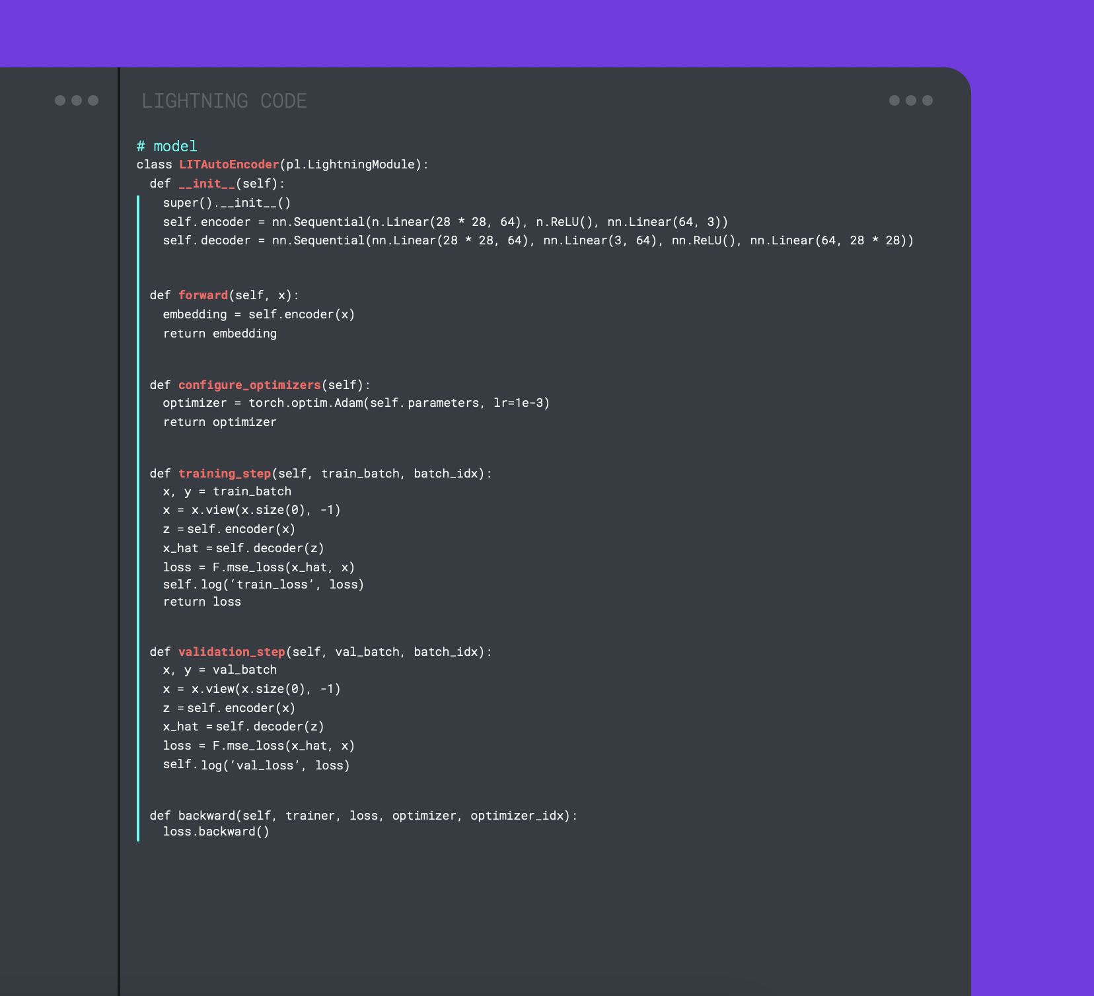
Beyond PyTorch
High Level Libraries / Distributed & Mixed Precision Training

Slide 33
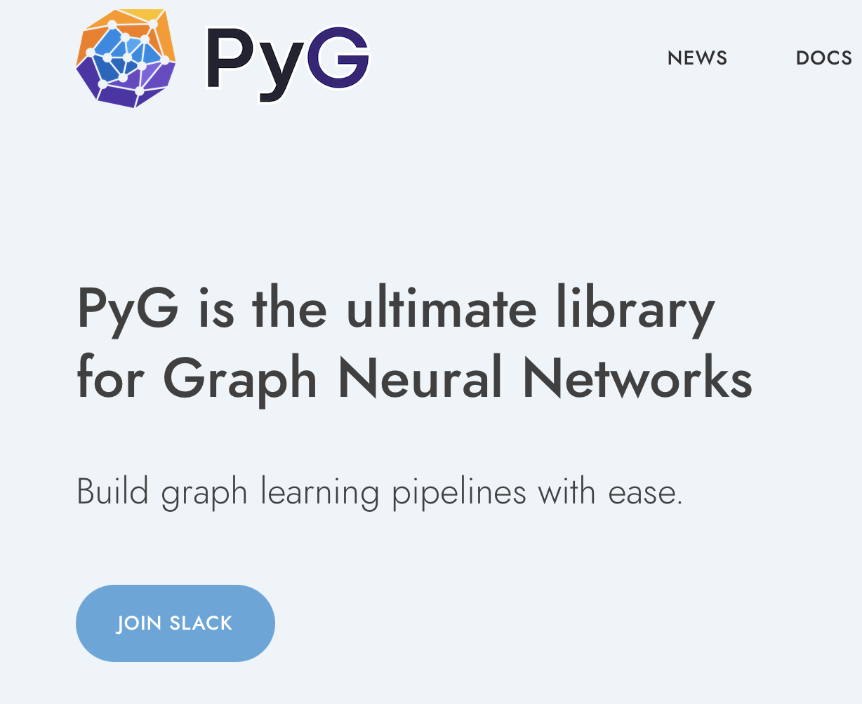
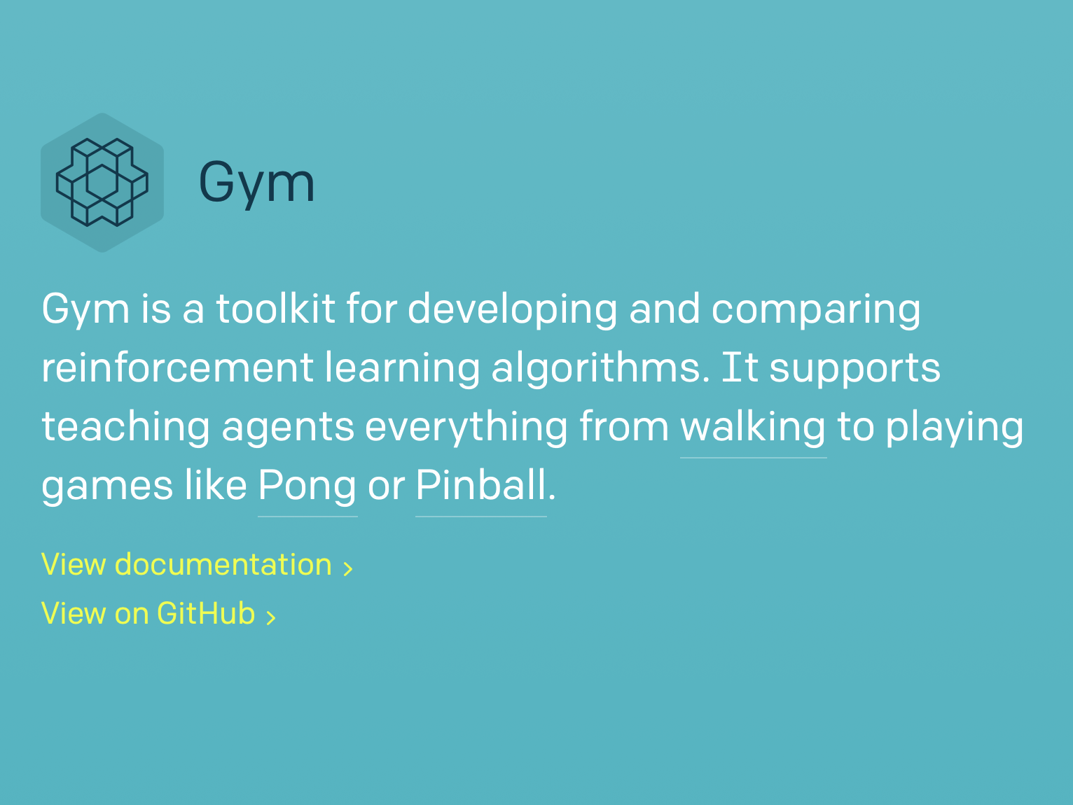

Beyond PyTorch
Domain Specific Libraries / Graph, RL, Probabilistic Programming

